Slide 1


Slide 2
Applications in Expedia
Auto-moderation of reviews
Entity extraction /sentiment analysis - reviews
Image classification
Image quality analysis
Open search
Hotel search result optimization
Package price prediction
Lodging supply - To find opportunity cost of a hotel
Hotel shell deduplication
Unsupervised intra-city clustering for personalization

Slide 3
Applications in Expedia .. Contd
City/Hotel clustering
Meta bidding(Trivago/SEM etc)

Slide 4
Auto-moderation Service - How do we do it?
We used Naïve Bayes Classifier – But why?
It is simple and if the conditional independence assumption actually holds, a Naive Bayes classifier will converge quicker than discriminative models like logistic regression, so you need less training data.
It requires less model training time
It is an anyhow decent choice when working with text classification
Handles missing data well using smoothing algorithms
Notes:
Laplace smoothing is important in chain rule so that posterior probabilities don’t suddenly drop to zero

Slide 5
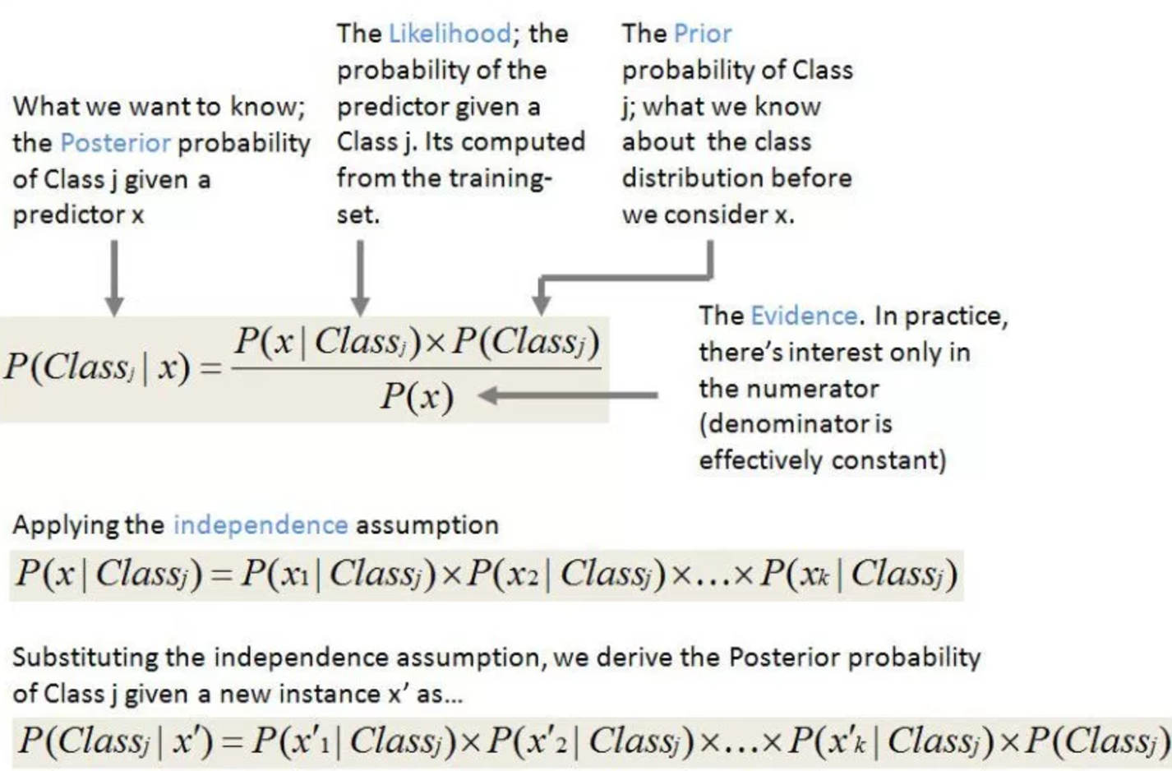
How does it work?
Notes:
NB is different kinds – Multinomial,Gaussian,Bernoili
Multinomial – probablity based
Gaussian – Normal distribution
Bernoilli – binary 0/1
What is bayes theorem :
P(A/C) = (P(C/A) * P(A))/P(C)
P(A/C) -> Posterior probability
P(A) – prior
P(C) – evidence
P(C/A) - Likelihood

Slide 6
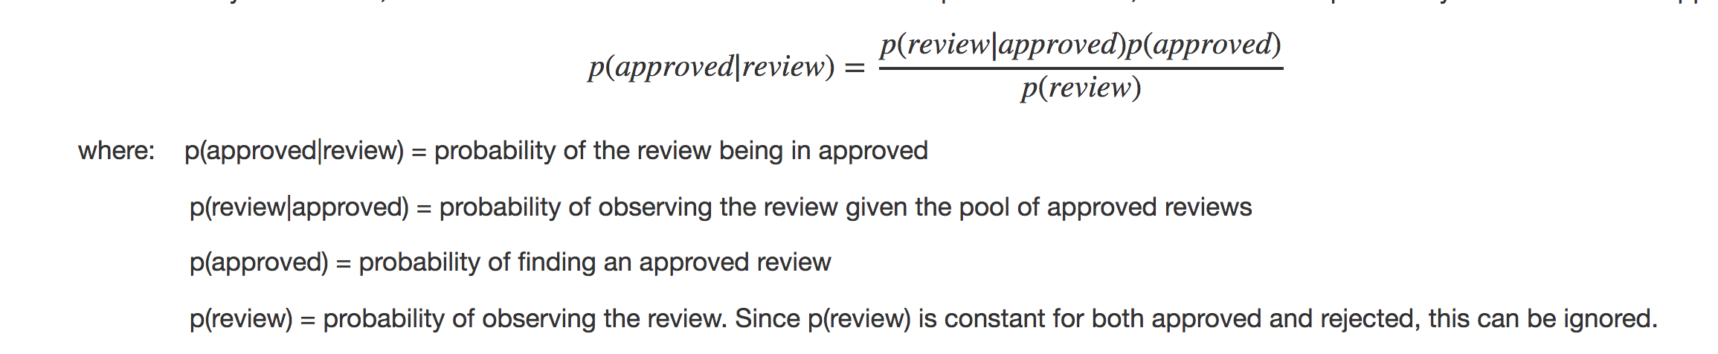
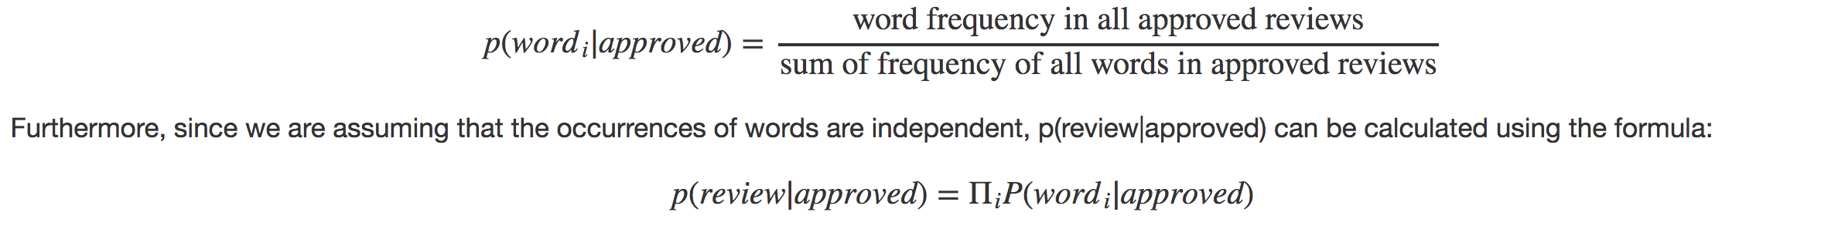
How does it work?
Notes:
Multinomial event model vs bernoille event model
Gaussian event model – For example iris data set
What is bayes theorem :
P(A/C) = (P(C/A) * P(A))/P(C)
P(A/C) -> Posterior probability
P(A) – prior
P(C) – evidence
P(C/A) - Likelihood

Slide 7
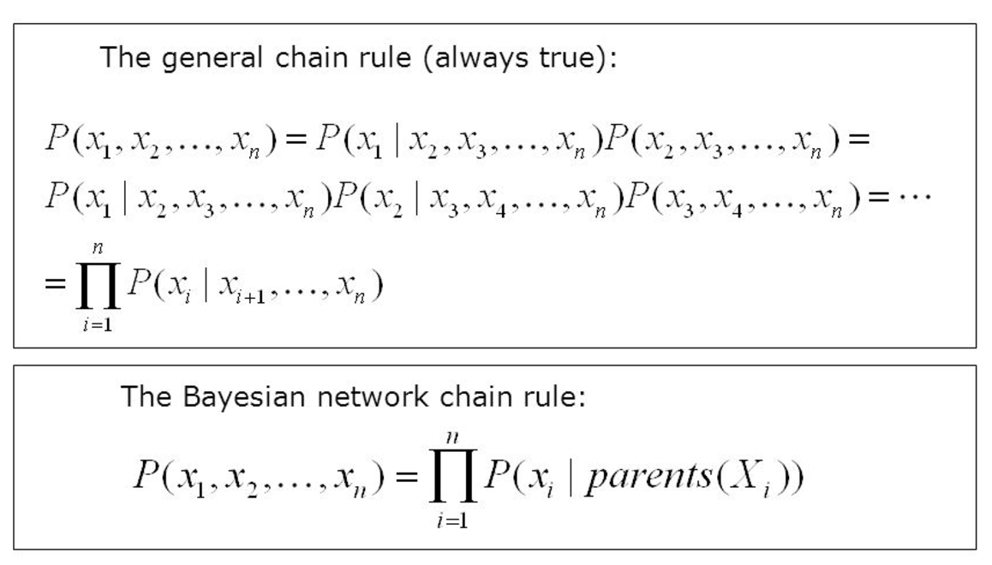
How does it work?
Notes:
What is bayes theorem :
P(A/C) = (P(C/A) * P(A))/P(C)
P(A/C) -> Posterior probability
P(A) – prior
P(C) – evidence
P(C/A) - Likelihood

Slide 8
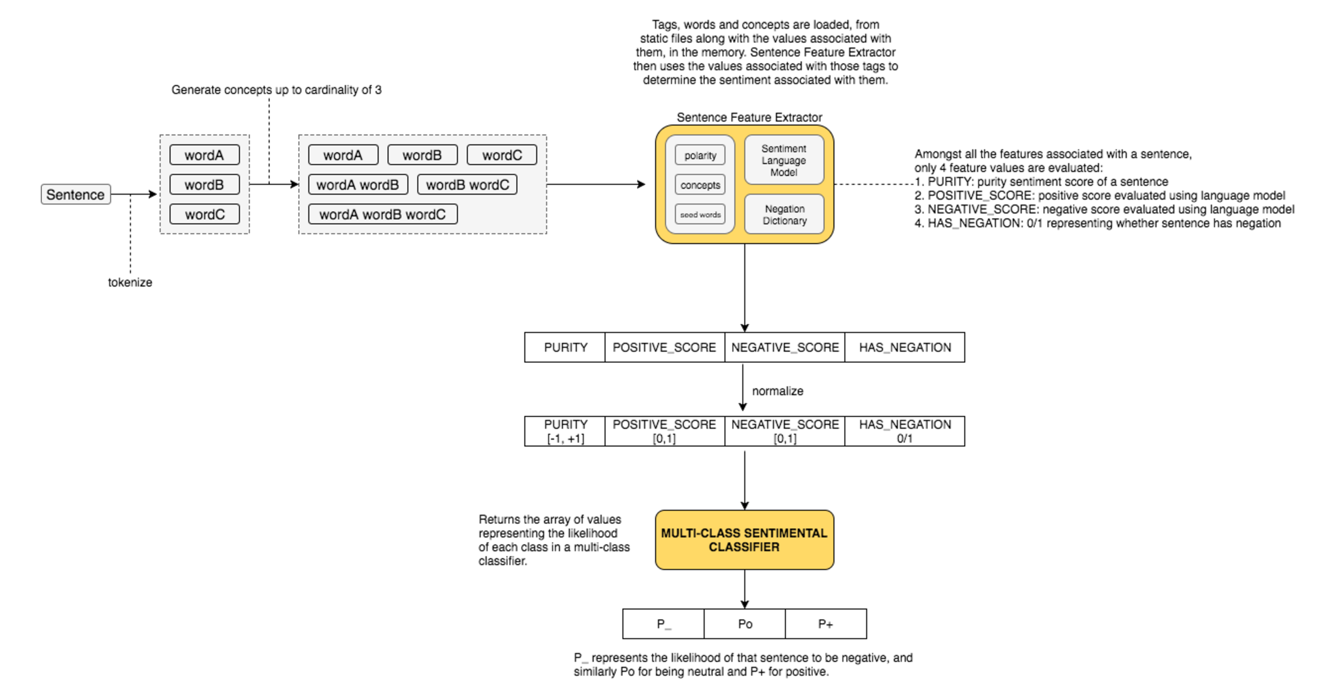
Sentiment Classifier – Today

Slide 9
Sentiment classifier - Future - Information Extraction Pipeline
Concept Extraction
Concept Resolution
Sentiment Analysis

Slide 10
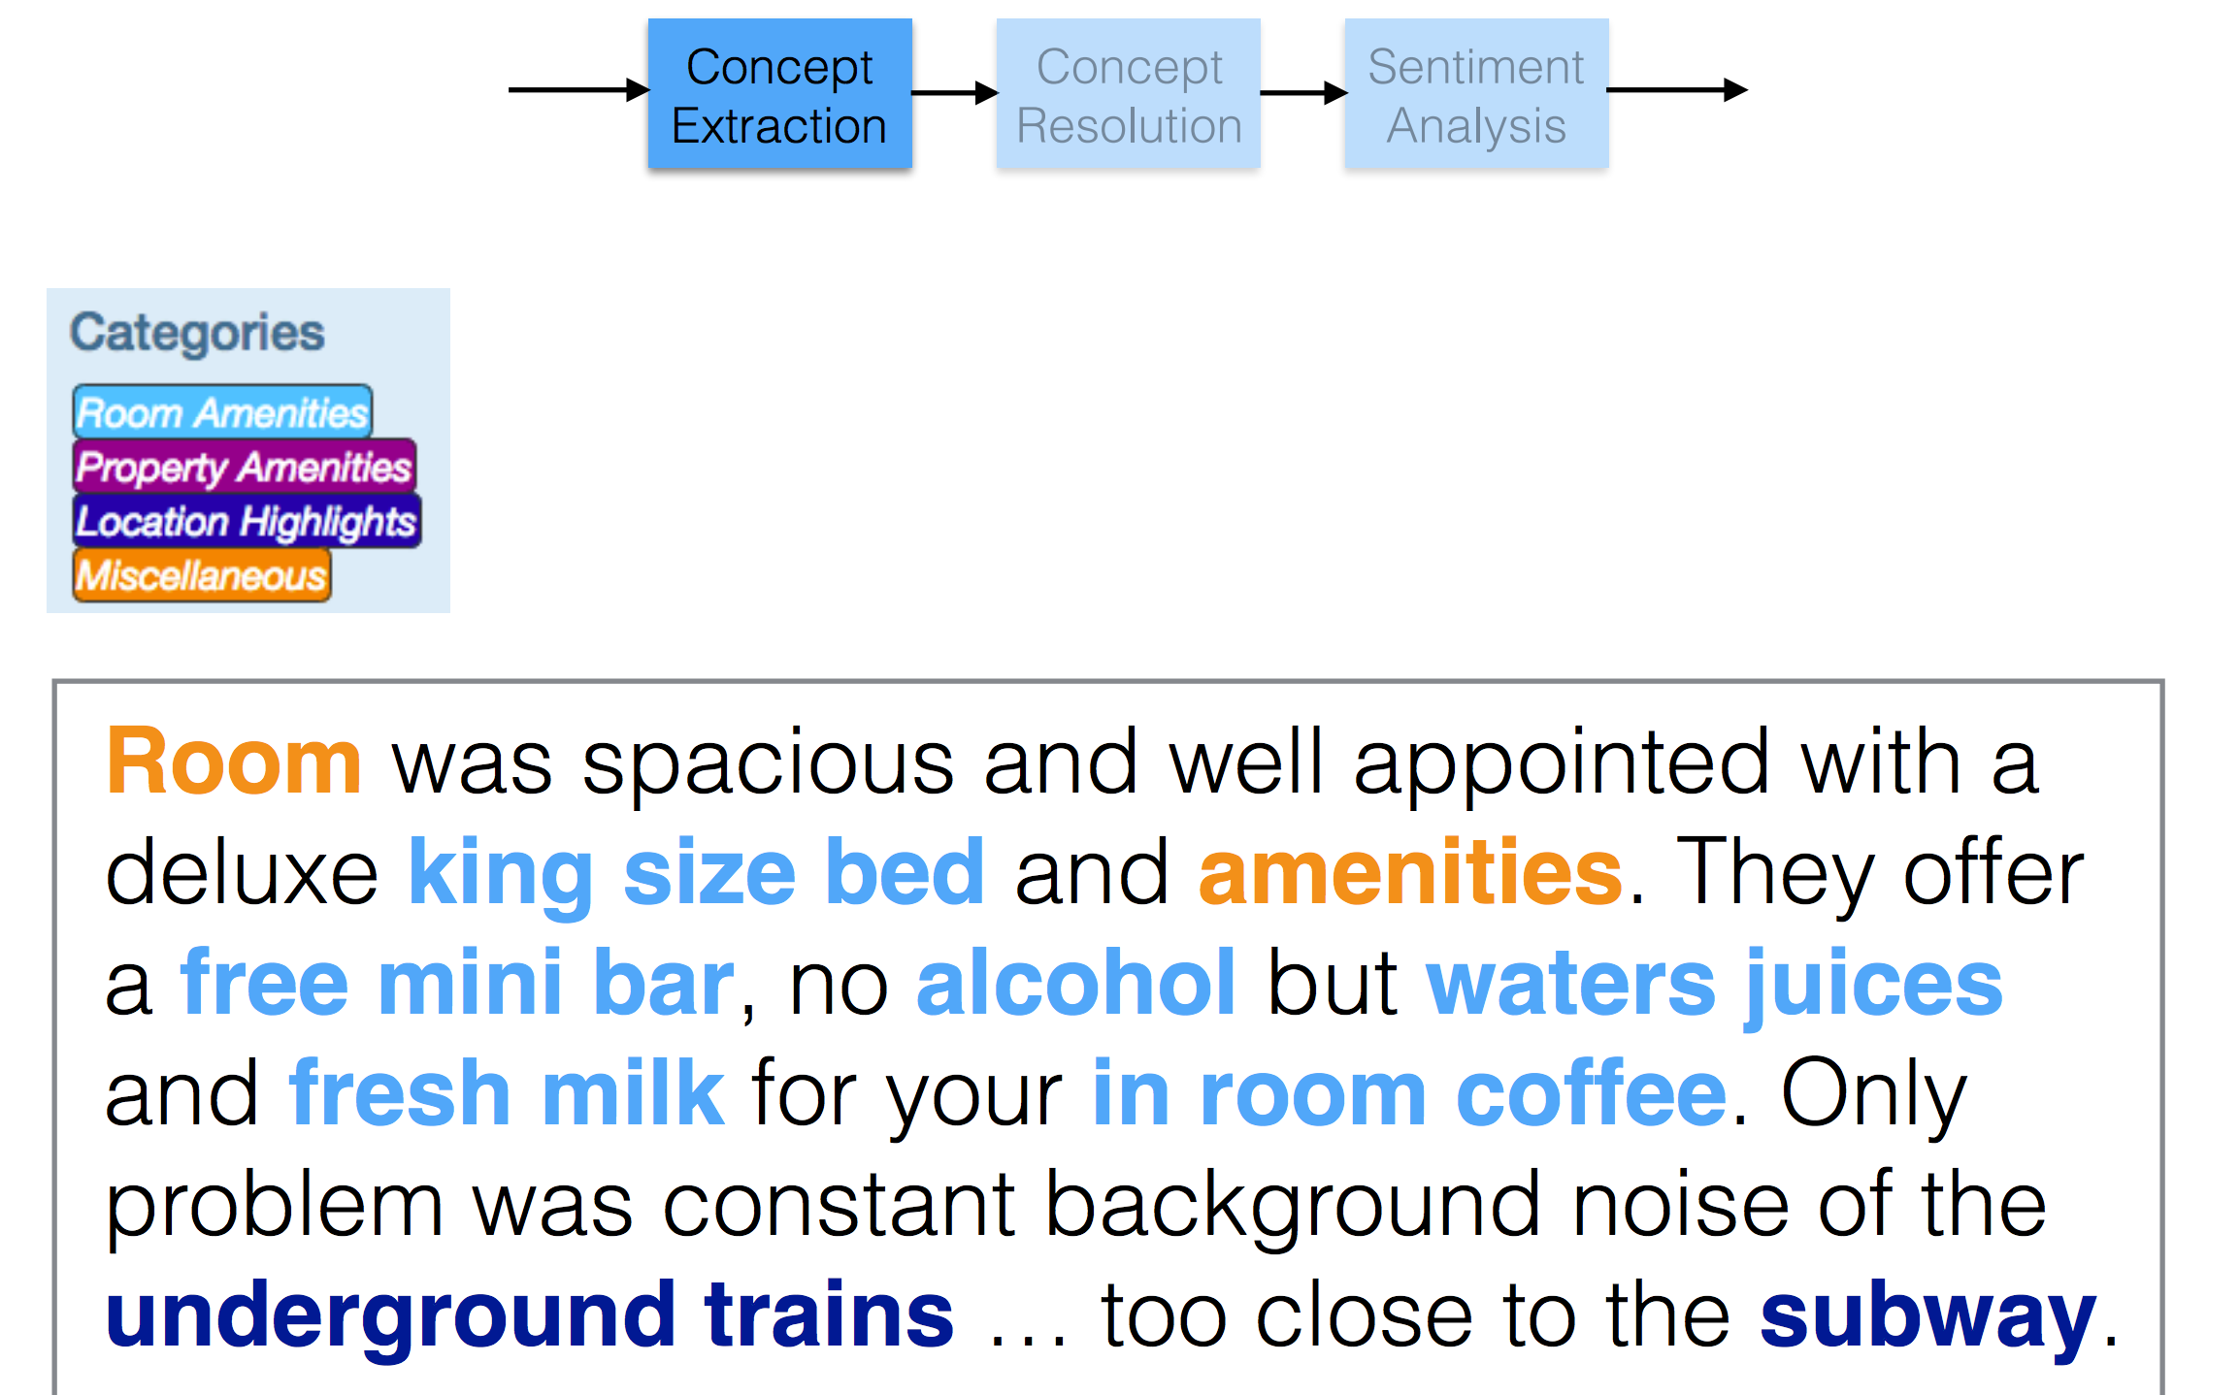

Slide 11
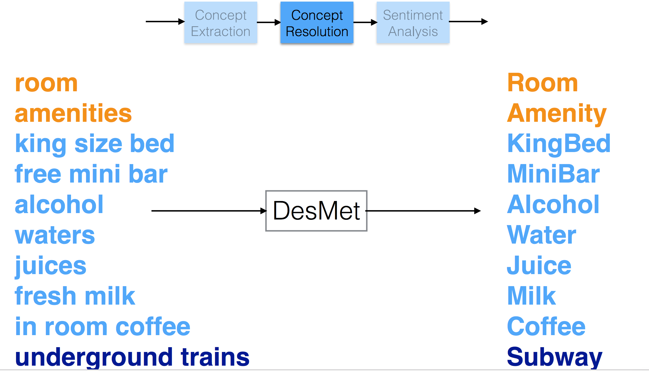

Slide 12
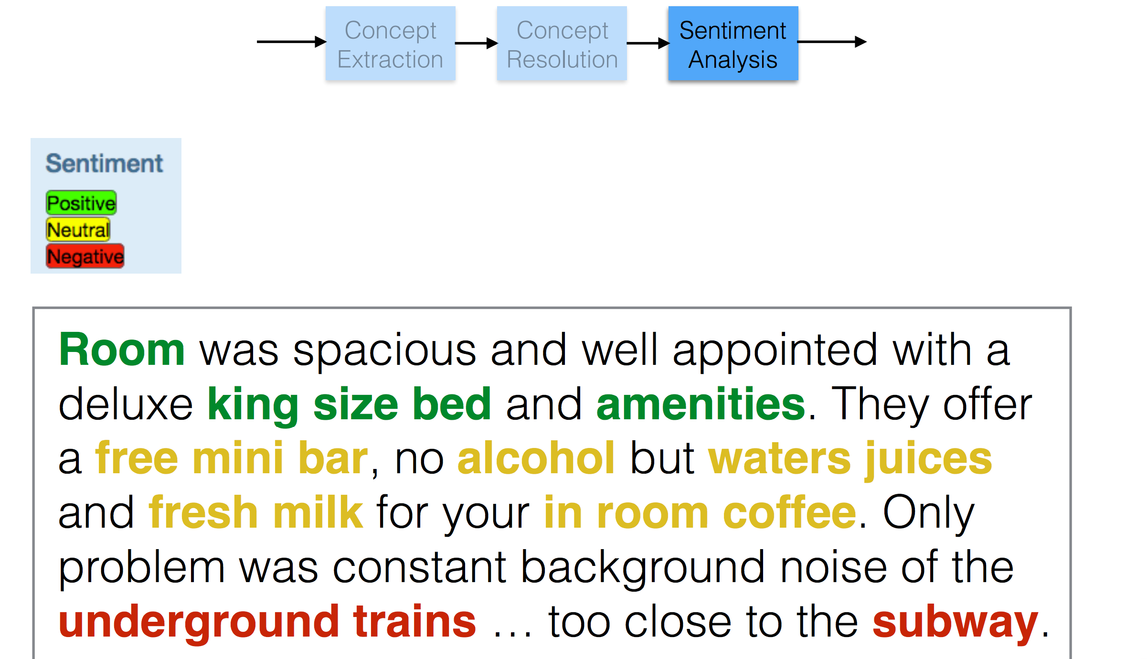

Slide 13
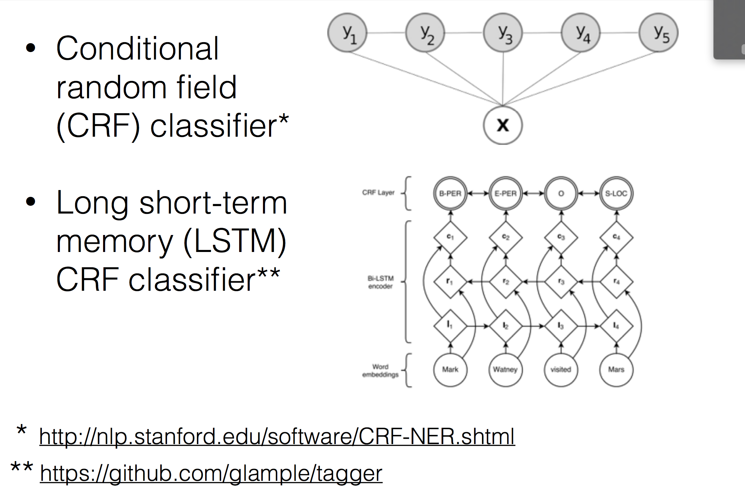
Concept Extraction

Slide 14
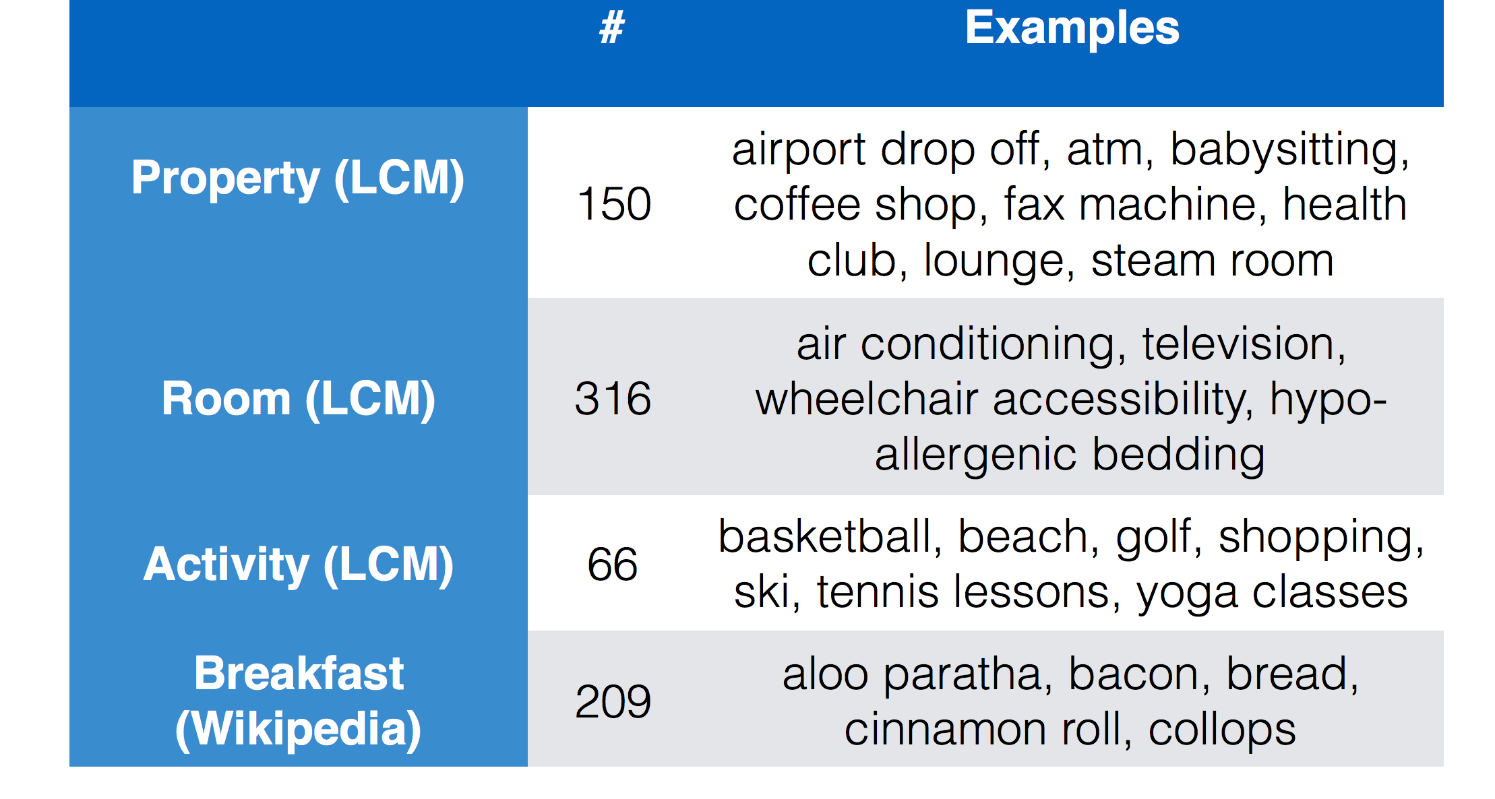
Concept Extraction

Slide 15
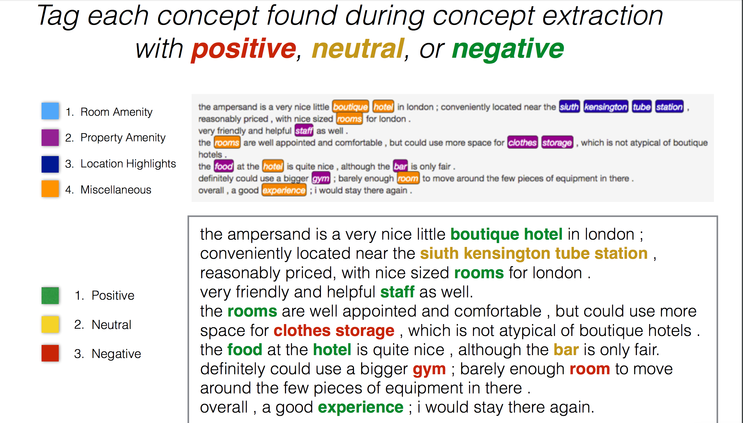
Sentiment Analysis

Slide 16
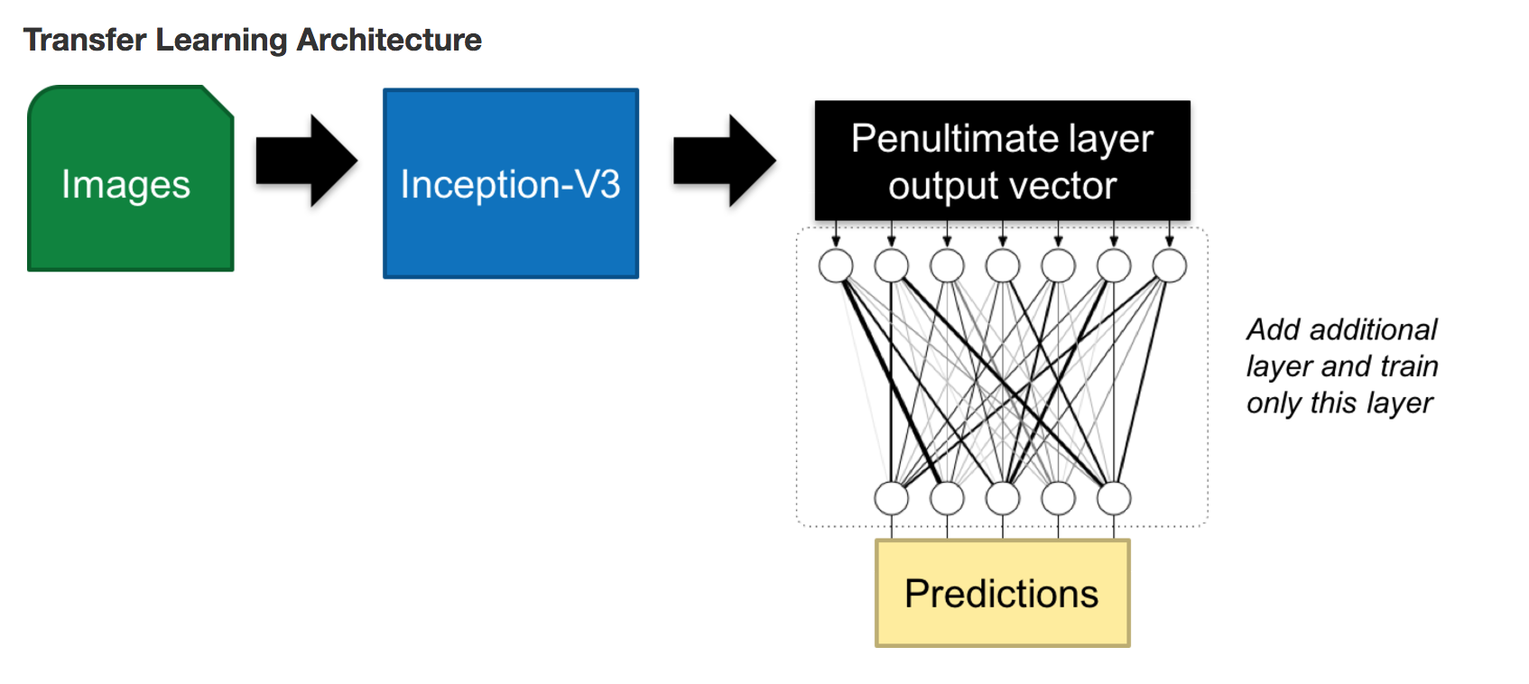
Image recognition using Tensorflow/Inception V3

Slide 17
PolloLoco -Image recognition using Caffe
Out of domain classification
Scene classification
Attractiveness ranking
Based on Caffe and Alexnet
http://image-classifier.pollo-loco.test.expedia.com/

Slide 18
Expedia Kaggle Competitions in the past
https://www.kaggle.com/c/expedia-hotel-recommendations
https://www.kaggle.com/c/expedia-personalized-sort/data

